Slide 1
Week 1
Introduction to Data

Slide 2
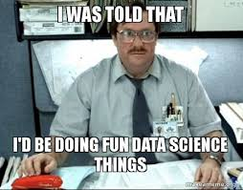
What is data
Data is facts
Data is values
Data can be collected

Slide 3
What is information
Information is what we can get out of the data
If data is a fact, information tells us why that fact is important
Data: The sky is Blue
Information: Blue skies indicate clear weather and unlikely to rain
If data is a value, information is what we can do with that value
Data: Temp is 90°
Information: Not a good day to wear a sweater
If data is collected, information is what we can use the collection for

Slide 4
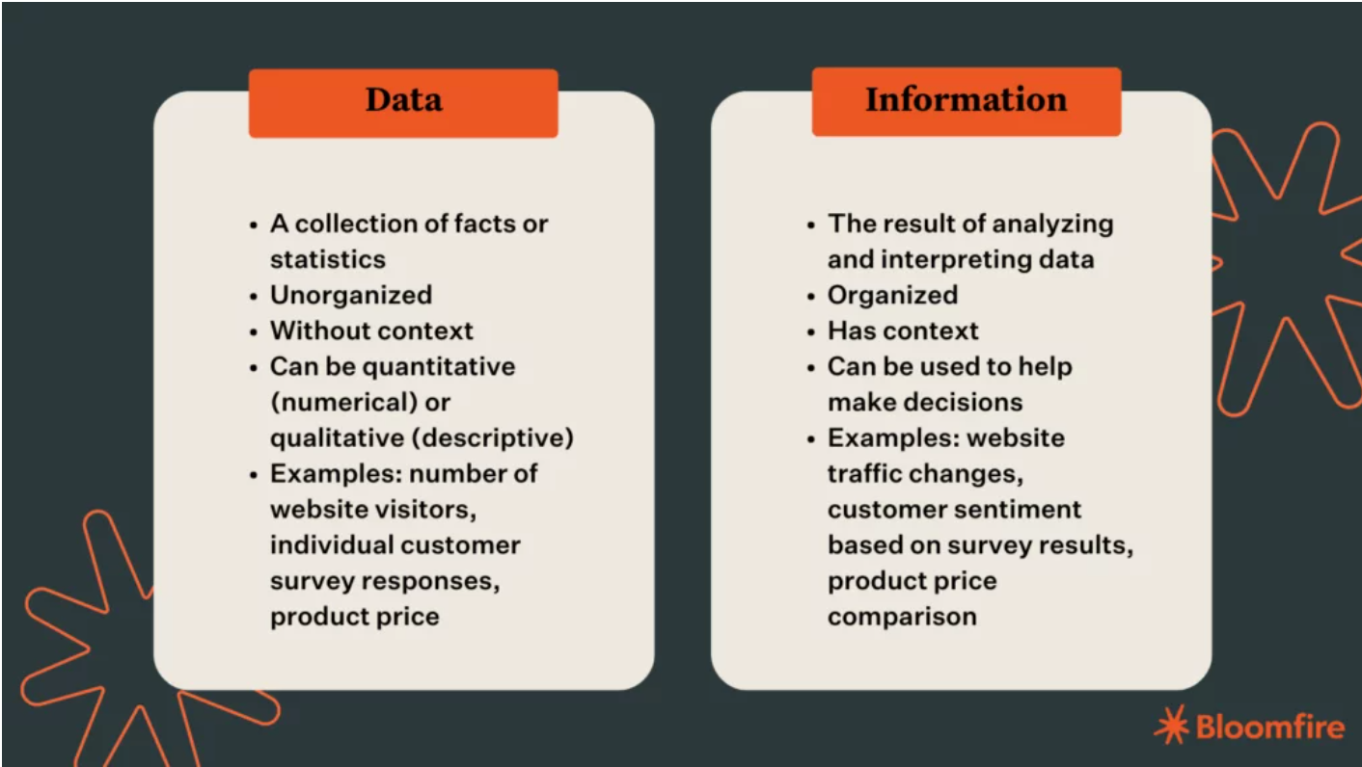
Data vs Information
https://bloomfire.com/blog/data-vs-information/

Slide 5
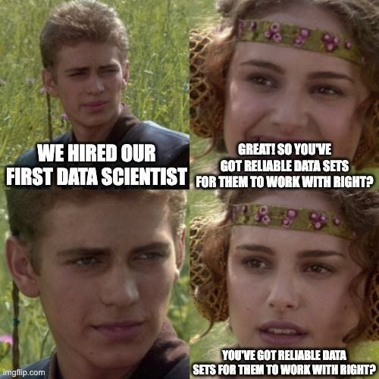
Collect your data
Data can be collected
Manually (take temp of day every hour)
Automatically (take temp through sensor every second)
When data is collected, it's important to pay attention to the form
Celsius vs Fahrenheit, or meters vs feet
Make sure to collect the same data (if it's books, collect title AND author not OR)
Data accuracy is important! Don't fudge or make things up. Blank is better than inaccurate
Measure all data in the same way (if you use a ruler make sure you are consistent with where you consider the "start")

Slide 6
Structure your data
Make sure it's in the same order so you don't have confusion of things like title vs author vs editor
If data is starting in something like a spreadsheet, rows vs columns is important!
Data labels are important, make sure each row, column or other is clearly labeled
You may want to specify the type of data expected, such as text, or single char, or integer, or float.

Slide 7
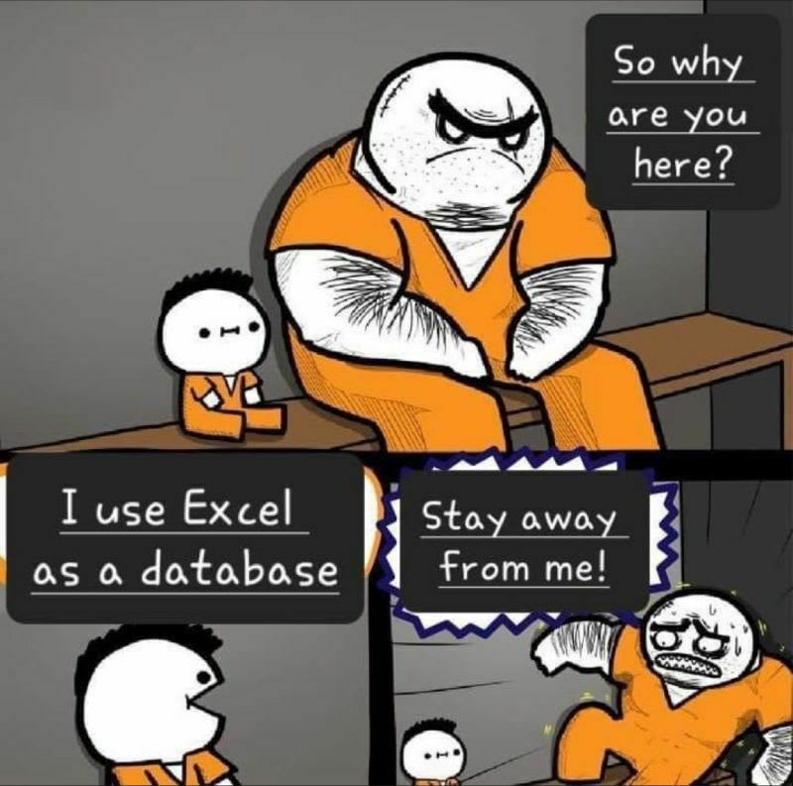
What is a database
A database is a collection of organized data
Databases store and organize data so you can get to it easier
Databases are good for larger amounts of data
Some examples of where a database might be useful
Customer information
Product or store information
Item collection information (Pokémon, Movies, Books)
Patient records
Student records

Slide 8
Why we have databases
Databases allow us to store more data easier than other formats, they also allow us to organize the data in lots of ways
Organized data allows us to run reports and queries more easily, so we can answer certain questions about our data
What is the email address for the customer? How many units did they buy last month? Last year? How much product have we sold last month? Last year?
Databases allow us to store and process our data, but also allow multiple other people to also store and process data
Centralized locations for data to ensure everyone is using the same data and has access to it allows for better business practices

Slide 9
How to get data into a database
You can import a number of different types of files including text, but CSV files are commonly used
Imports can also happen from other programs including spreadsheet programs or other database programs
If you're using SQL you can use a create table or insert command to get your data into your database
There are also some Graphical options depending on the database type you're using
You can also write a script to enter in your data

Slide 10
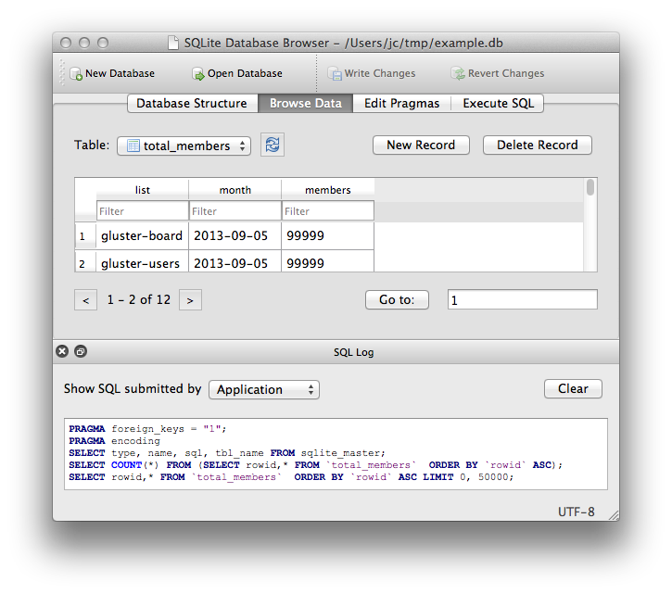
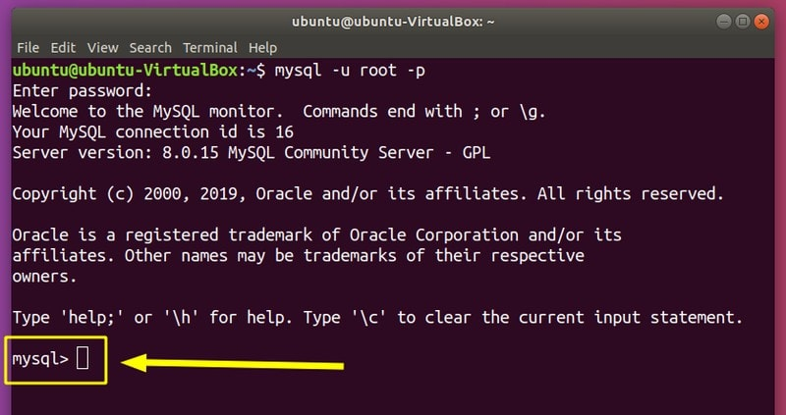
How databases look different on different systems
Databases can be access by either Graphical User Interface (GUI) or Command line
The system you're using will affect how the data is stored and where it's being used
https://itsfoss.com/basic-sql-commands/
https://sqlitebrowser.org/

Slide 11
Different between how the data is stored and how it's accessed
You can have many different front end options
There are a lot of GUI options that can look very different
Each may have different steps used for each thing you want to do
Dashboards are also commonly used for people that need to see but not change the data
Databases will save the information on your computer but that will depend on what database is installed, which can be different then the front end used
Databases can also be on servers and in the cloud, the front end would connect to those for viewing
Generally only a few people may change the data, but many more will be able to see the data

Slide 12
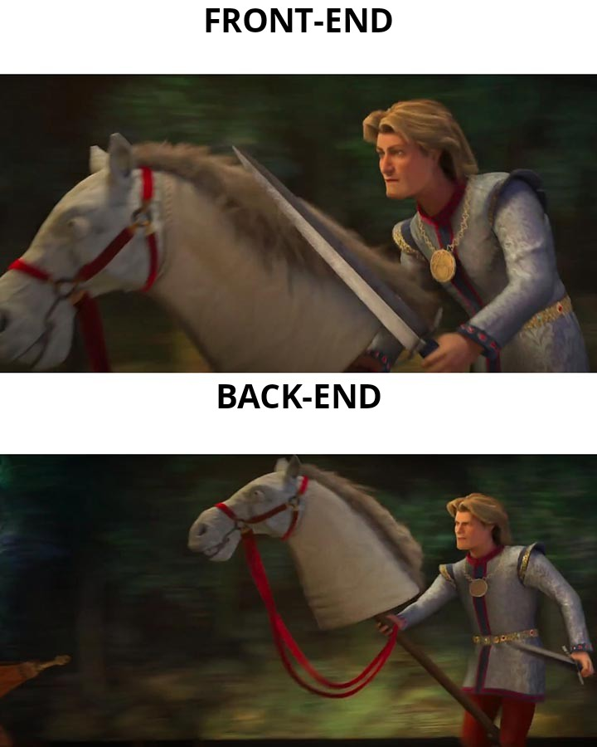
Examples of front ends
You can build your own, but a lot of people use already made options
Your front end can be as simple or complex as you like, some are free, some are not.
Some database front end options can be very complex and include data analytics and visualizations, examples include Tableau, MS Power BI, Oracle Analytics Cloud and AIMMS

Slide 13

Data Dictionary
A data dictionary is an explanation of the data saved in our database.
Should be centralized so everyone using the database is seeing the same definitions.
Clarity can be an issue
Names listed aren't always obvious, and descriptions can be lacking
Active dictionaries are created within the database and auto updated, passive are separate and must be updated manually

Slide 14
Keys
Primary Key
Foreign Key
Unique Identifier for each record
Used to be Numeric only
You're NOT supposed to use data (i.e not social security numbers) but people do
Identifier for connecting to the primary key, linking the data in the tables
Always point to a primary key
Some databases call both foreign key AND primary key the ID (<--BADBAD)

